Slide 1

Abstractions for Life-Science Applications
Shantenu Jha, Andre Luckow
In collaboration with Joohyun Kim, S Maddineni, Mark Santcroos, Ole Weidner
http://saga.cct.lsu.edu
Notes:
Added slide 3
I think there will not be time to focus on “assertion based” approach, i.e slides 4-7. Possibly include slide 8

Slide 2
Overview
Introduction: Understanding Distributed Abstractions
Unique Role for Abstractions for Distributed Applications
Life Science Applications – Data & Compute Intensive, often require many (heterogeneous) ensemble based simulations:
Abstractions for dynamic executions: “Intelligent” Pilot-Job
Application Exemplar I: EnMD and RE Simulations
Pattern not quite amenable to CIRRUS, but explore native abstractions that Azure provides
Architecture, Performance and Scalability
Application Exemplar II: Analyzing NGS Data using BFAST
Understanding basic computational “characteristics”
Towards a Community Cloud-based solution?

Slide 3
Some Primary Observations
Space of Distributed Applications (DA) Is large (and rich), but the number of effective and extensible DA small
More than just submitting jobs here and there!
Developing DA is a hard undertaking
Intrinsic and Extrinsic Factors:
Coordination across resources & Execution Environment
Embrace “distributedness”
Understanding distributedness -- data-centric application will be the drivers!
Heterogeneity & dynamic execution is fundamental
Points 2 & 3: Point to a unique role for Pattern-oriented and Abstractions-based Development of Distributed Applications

Slide 4
#2: Developing DA is a hard undertaking
Intrinsic reasons why developing DA is fundamentally hard:
Control & Coordination over Multiple & Distributed sites
Effective coordination in order for whole > sum of the parts
Complex design points; wide-range of models of DA
Many reasons for using DA, more than (just) peak performance
Extrinsic:
Execution environments will be dynamic, heterogeneous and varying degrees-of-control
Fundamental different variation in role of Execution Environment- distinguishing feature of DA from “regular environment” HPC
Application types strongly coupled to the infrastructure capabilities, abstractions/tools, & policy:
Often development tools assume “specific” deployment and execution environments, or don’t where needed!
Policies and tools, e.g production DCI has been missing for DDDAS

Slide 5
#3: Embrace Distribution Corollary: Clouds are not Panacea
Clouds: Novel or more of the same?
Better control over software environment via virtualization
Illusion of unlimited and immediate available resource can lead to better capacity planning and scheduling
Clouds do not remove many/all of the challenges inherent in DA
Clouds are about provisioning, grids are about federation
Fundamental challenges in distribution remain
Makes some thing worse as impose a model of strong localization
Programming models that provide dynamic execution (opposed to static), address heterogeneity etc
“The reason why we are so well prepared to handle the multi-core era, is because we took the trouble to understand and learn parallel programming” – Ken Kennedy
Clouds part of a larger distributed CI
Certain tasks better suited for Grids, others on Clouds
Notes:
“Clouds are about provisioning, grids are about federation”
“IF you can keep your head when all about you, Are losing theirs and blaming it on you..”
“The reason why we are so well prepared to handle the multi-core era, is because we took the trouble to understand parallel programming

Slide 6

SAGA: In a nutshell
There exists a lack of Programmatic approaches that:
Provide general-purpose, basic & common grid functionality for applications; hide underlying complexity, varying semantics..
The building blocks upon which to construct “consistent” higher-levels of functionality and abstractions
Meets the need for a Broad Spectrum of Application:
Simple scripts, Gateways, Tooling, Workflow…
Simple, integrated, stable, uniform and high-level interface
Simple and Stable: 80:20 restricted scope and Standard
Integrated: Similar semantics & style across
Uniform: Same interface for different distributed systems
Standards-based approach: A Technical and an Economic (Moral?) imperative & case:

Slide 7
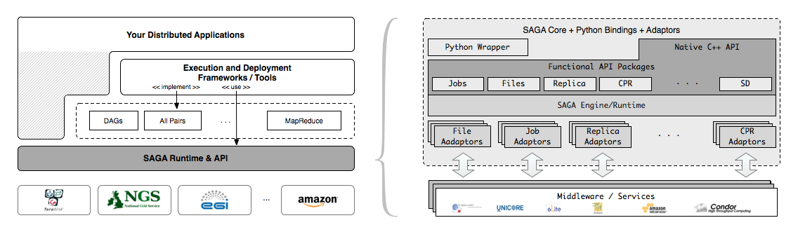
SAGA – An Overview

Slide 8
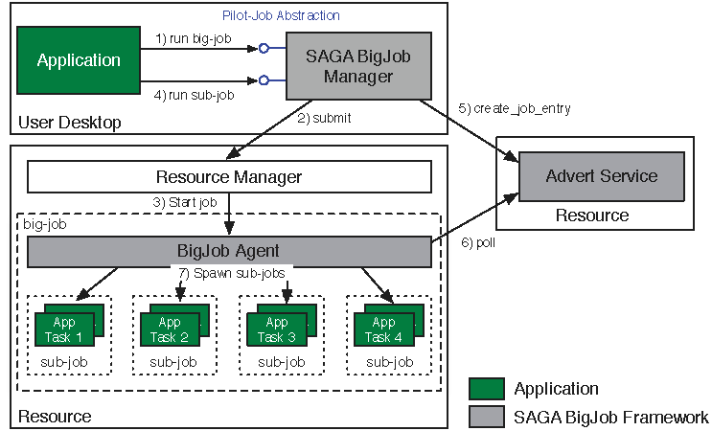
Abstractions for Dynamic Execution SAGA Pilot-Job (BigJob)

Slide 9
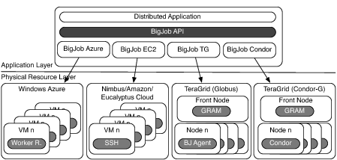
Deployment & Scheduling of Multiple Infrastructure Independent Pilot-Jobs

Slide 10
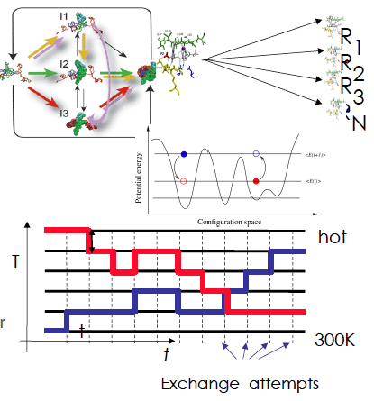
Ensemble and Replica-Exchange Simulations
Replica-Exchange (RE) methods:
Represent a class of algorithms that involve a large number of loosely coupled ensembles.
RE simulations are used to understand a range of physical phenomena
Protein folding, unfolding etc
MC simulations
Many successful implementations
e.g. folding@home [replica based]

Slide 11
BigJob for Azure
Azure BigJob library calls Azure APIs directly
BigJob Manager launches requested number of worker roles using the Service Management API
Python library created for this capability
BigJob Agents run within the worker roles (C#/.Net)
Primary responsibility to execute MD code
MPI-based MD tasks confined to a single worker role (8 cores)
For each sub-job, the BM creates a work-package
Distributed to agents using AQS – reliable and scalable msgs
Agents query AQS for new work-packages
Stage data from ABS

Slide 12
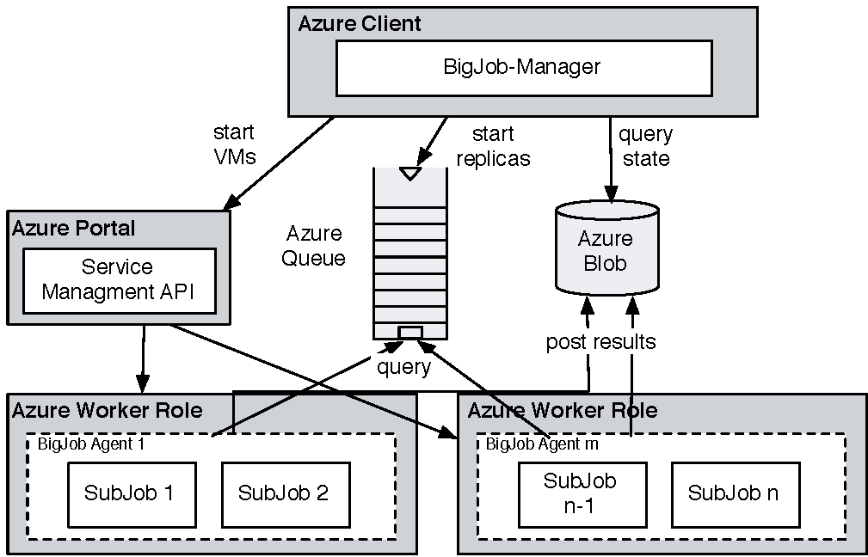
Coordinating Multiple Tasks Using BigJob for Azure
Support for Affinity Groups
Multiple Affinity Groups supported within the same BigJob for different worker-roles

Slide 13
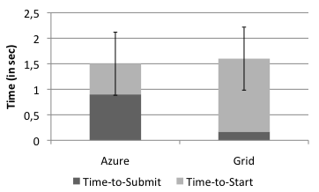
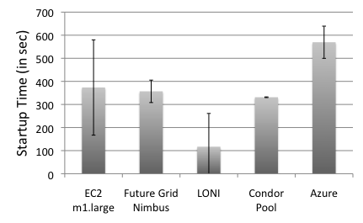
Pilot-Job for Azure: SAGA BigJob
BigJob Startup Times
In Grids the BigJob startup time depends mainly on queuing time
Azure shows a longer startup than Amazon EC2 and FutureGrid
Correlated to system load
Amazon EC2 has the highest fluctuation in the startup time (of all cloud resources)
Sub-Job submission times are comparable
BigJob Sub-Job Submission Times

Slide 14
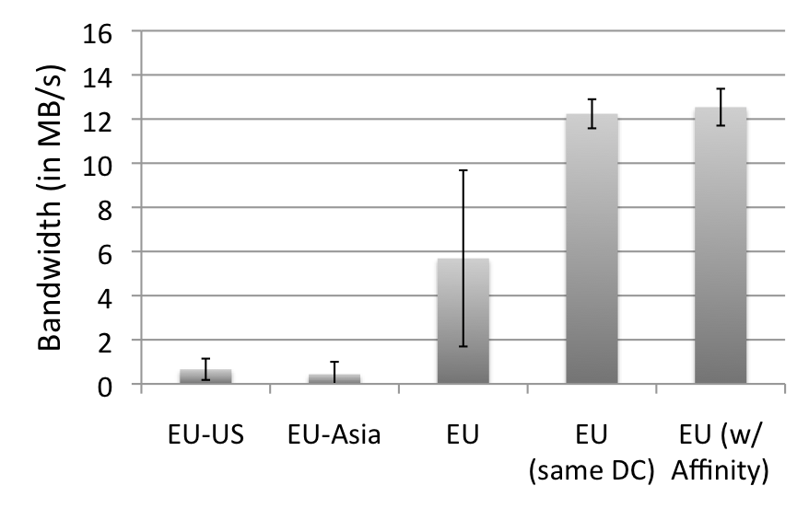
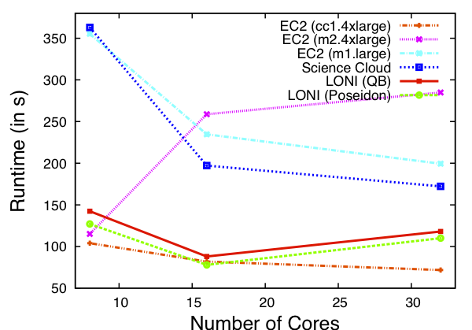
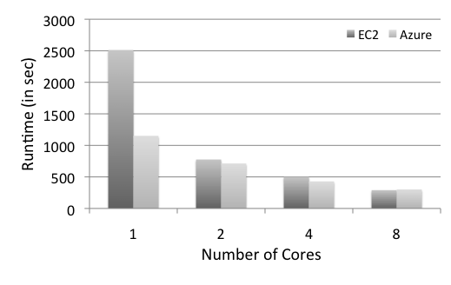
Azure: Scalability with Simplicity Providing Infra-level abstractions for DDIA
NAMD Performance on Azure
Three types of storage abstractions:
Azure Blob Service: Large amounts of raw data
Block Blob: Large chunks of 5GB
Page Blob: Mange storage as an array
Azure Table Storage: Semi-structured data
Azure Queue Storage: Message Queues
All three replicated and with strong consistency semantics
Current affinity operates at the data-center level;
Enhanced/finer-grained affinity to be made available

Slide 15
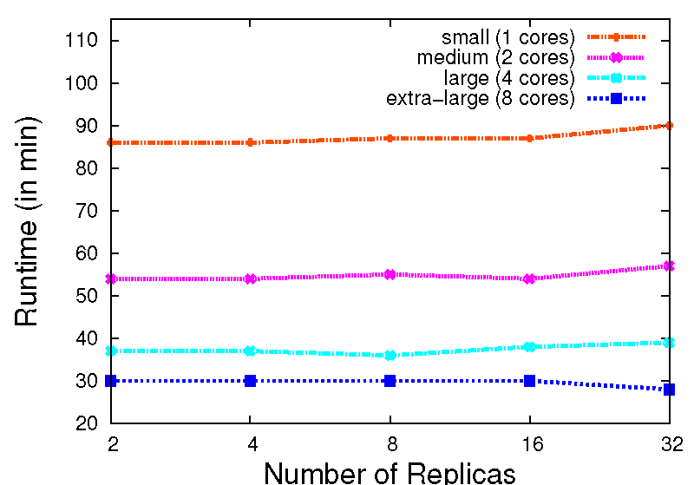
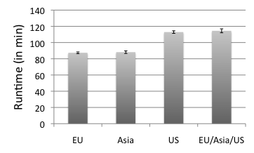
Replica-Exchange on Azure
Azure BigJob scales well with the number of replicas.
AQS proved to be effective for coordination of sub-jobs/replicas
Larger VMs have a better performance. But, efficiency drops < 0.4 for the extra-large VM
The different Azure data centers show a slight fluctuation in their performance
16 replicas, small VM

Slide 16
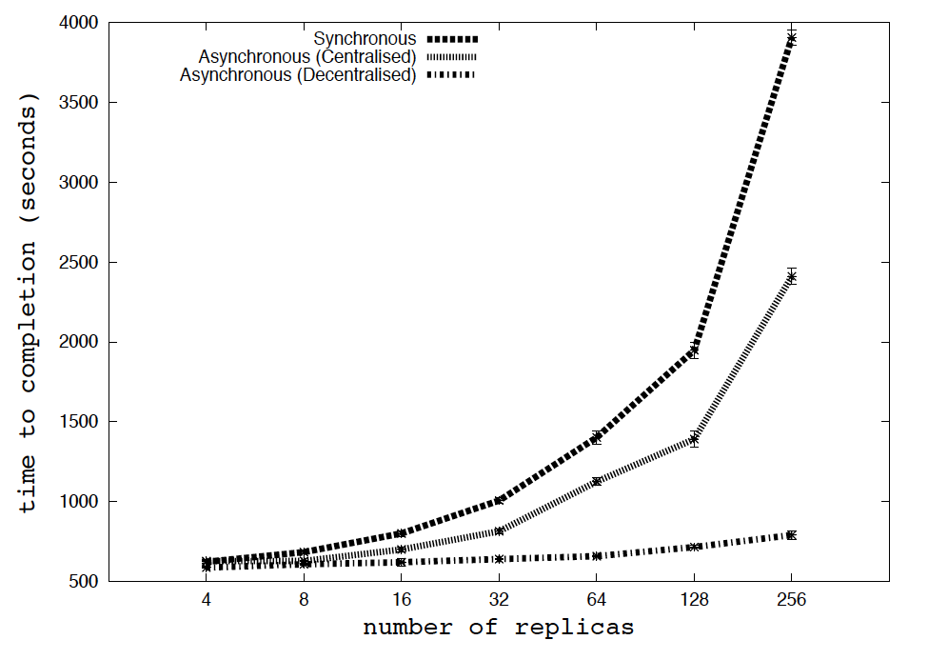
RE Algorithms (TeraGrid) Understand Algorithms at Scale on Azure?

Slide 17
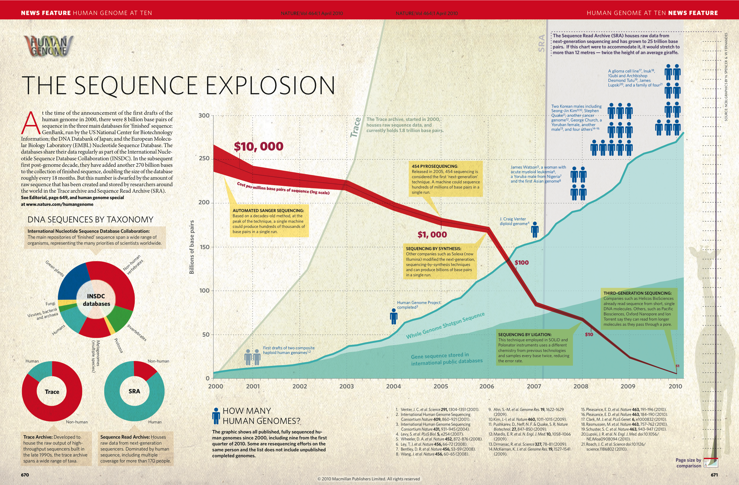
Next-Generation DNA Sequencing (NGS) and Its Impact on Life Sciences
Nature, 464, 670 (2010)

Slide 18
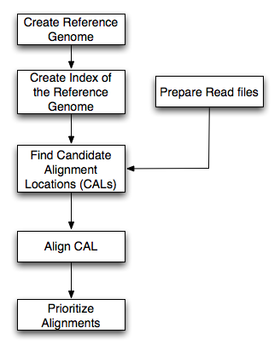
DARE-NGS : Mapping on Scalable Distributed HPC resources
BFAST
Higher sensitivity (CAL finding and gapped Smith-Waterman alignment)
Relatively larger memory and disk space
Multi-threading support
Low-memory option (index file splitting)
Pipeline (index, match, localalign, and postprocess step) and extensible (e.g. BFAST-BWA for paired-end, and more)
Task Level concurrency (Data fragmentation of Reads and Chromosomes, different spaced seeds (match step), parallel task runs (localalign, postprocess steps)
Workflow for bfast match step
Ref. Genome
Mapping
(Bfast)
SNP finding
NGS short reads

Slide 19
DARE-NGS : Mapping on Scalable Distributed HPC resources
Human Genome (HG18) and Burkerholderia Glumae :Prokaryote vs. Eukaryote
 |  | B. Glumae | Human Genome | Human- Chr 21
Genome Size |  | 7 Mbp | 2.8Gbp (hg18) | 47 Mbp (hg18-chr21)
NGS Type |  | Whole Genome | Exome | Exome
NGS Data Size |  | 12.6 GB | 5.6 GB | 5.6 GB
Ref. Index Data | 40 index files^{b)} | 40 GB | 130 GB | 70 GB
 | 10 index files
Minimum Memory^{b)} | 40 index files | 38/4 MB + α^{c)} | 3 GB + α | 164/4 MB + α
 | 10 index files | 38 MB + α | 12 GB + α | 164 ΜΒ + α
Two options generating 40 index files and 10 index files are considered
The cases with 10 index files. The option generating 40 index files require ¼ memory but needs 4 time computation
Data volume of a read file

Slide 20
Distributed Computing: Solution or Complexity?
Task Level Concurrency and Scale-Out
Compute System | # of cores | # of tasks | Task Concurrency | Bfast (mapping)
Workstation | 4 | 8 | No | ≈18 h
Ranger | 64 | 4 | Yes | 6.5 h
Ranger | 128 | 8 | Yes | 3.4 h
Ranger | 256 | 16 | Yes | 1.95 h
Case | HPC System | # of cores | Bfast (mapping)
I | QB | 256 | 2.66 h
II | Ranger | 128 | 2.11 h
 | QB | 128
Read Data
(12 GB)
Reference Genome
I
II
Notes:
(JK) Here, upper two tables represent the benefits of task level concurrency and scale-out strategy

Slide 21
DARE-NGS : Mapping on Scalable Distributed HPC resources
Time to Completion (Match Step) vs. Short Read File Size
HG18
HG18-Chr21
B.Glumae
Time to Completion (Match Step) vs. Num. of Threads

Slide 22
DARE-NGS : Mapping on Scalable Distributed HPC resources
The Importance of Dynamic execution utilizing the information about target species, NGS protocol, multi-core, cluster environment, disk space, memory, and available task level parallelism
Single Machine
HPC cluster with BigJob
Case | Read File Size(GB) | # of Task | Threads/task | Bfast (Mapping)
s1 | 2.4 | 1 | 4 | 2.6
s2 | 1.2 | 2 | 2 | 1.5
s3 | 0.6 | 4 | 1 | 2.5
s4 | 0.6 | 4 | 4 | 1.6
Case | Read File Size (GB) | # of Task | BigJob size | Bfast (Mapping)
g1 | 0.21 | 40 | 80 | 1.1
g2 | 0.44 | 20 | 40 | 2.2
g3 | 0.21 | 40 | 12 | 7.2
g4 | 0.44 | 20 | 12 | 6.6
Notes:
This will be very hard to read!

Slide 23
Data -- Challenges
Challenges and Ongoing investigation
Distributed data management
Data transfer of Reference genome index files : HG18 : 130 GB, B.Glumae :447 MB
Data transfer of Short read files : e.g. 9 GB (about 2 min from local to QB using GridFTP)
Data Transfer (130 GB)
protocol | Local -> QB | Local -> Ranger | QB -> Ranger
SCP | 33 MB/s (1 h) | 1.8 MB/s (20 h) | 1 MB/s (36 h)
GridFTP | 70 MB/s (0.5 h) | 6.8 MB/s (5.3 h) | 25 MB/s (1.4 h)

Slide 24
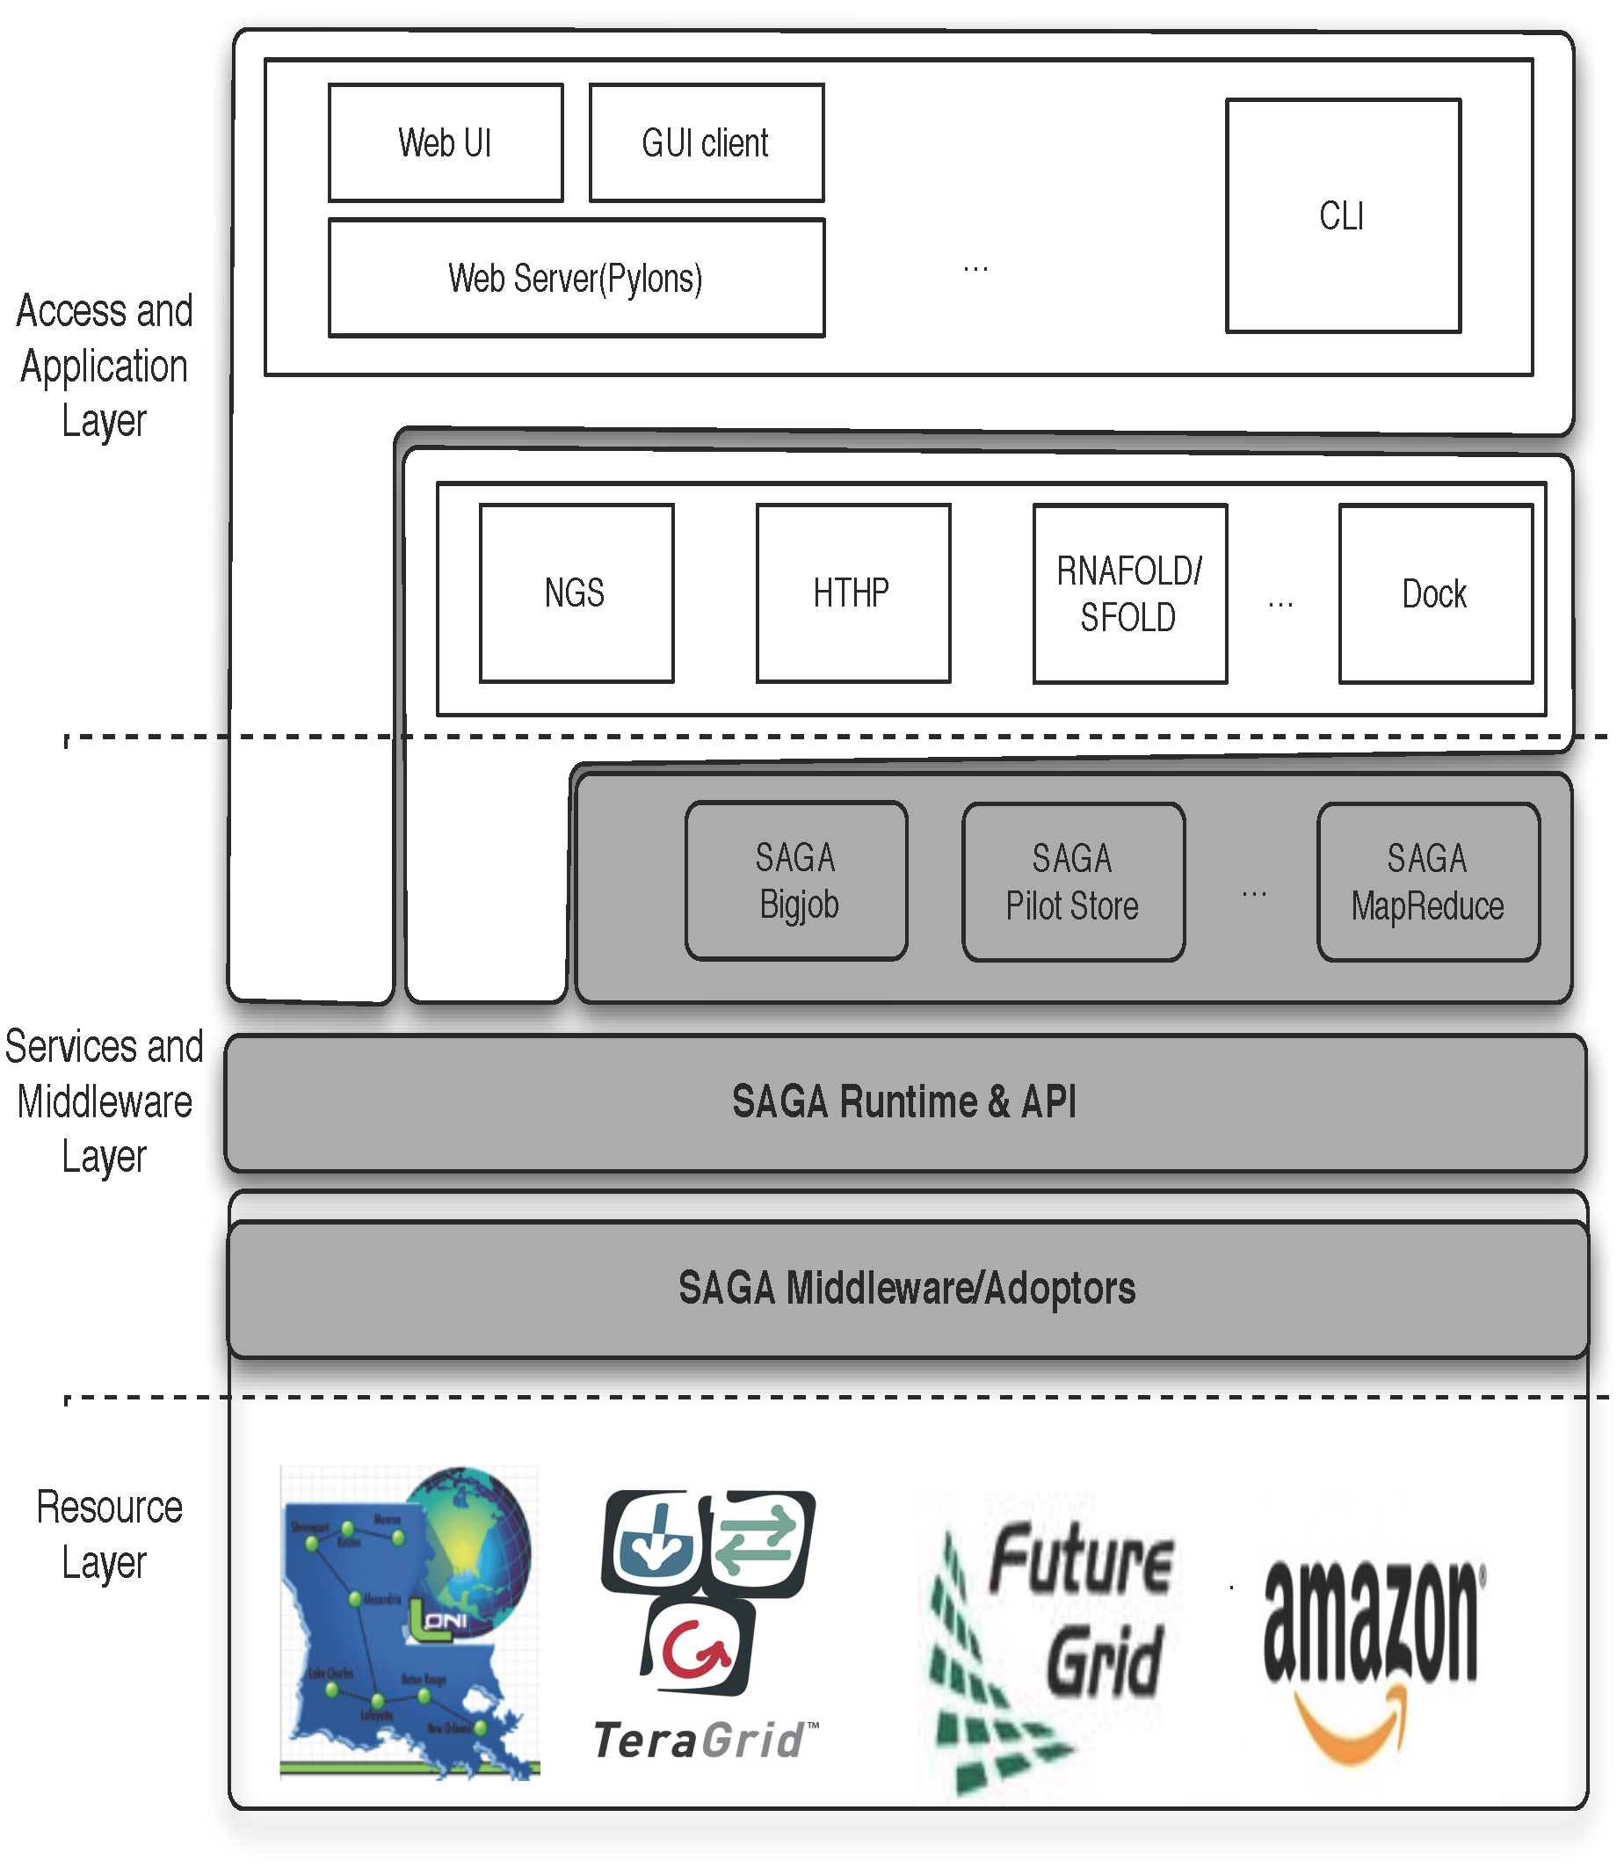
DARE
Notes:
Fixed the diagram.. Please remove next slide if you are OK with this

Slide 25
Conclusions
Relative Ease of implementation of the R-E Pattern
Thanks to combination of appropriate system-level abstractions (AQS) and user provided abstractions (BigJob)
“Trivially use distributed resources”
Performance comparable to TG
Cost of virtualization not a first order concern
Efficient and scalable messaging
Starting point for more sophistication implementations
Affinity becomes more fine-grained, data-compute affinity
Extensions to abstractions for dynamic data

Slide 26
Futuregrid Acknowledgement
This document was developed with support from the National Science Foundation (NSF) under Grant No.0910812 to Indiana University for "FutureGrid: AnExperimental, High-Performance Grid Test-bed." Any opinions, findings, and conclusions or recommendationsexpressed in this material are those of the author(s)and do not necessarily re ect the views

Slide 27
Azure: Scalability with Simplicity Providing Infra-level abstractions for DDIA
NAMD Performance on Azure
Three types of storage abstractions:
Azure Blob Service: Large amounts of raw data
Block Blob: Large chunks of 5GB
Page Blob: Mange storage as an array
Azure Table Storage: Semi-structured data
Azure Queue Storage: Message Queues
All three replicated and with strong consistency semantics
Current affinity operates at the data-center level;
Enhanced/finer-grained affinity to be made available
Azure Network Performance

